Slide 1
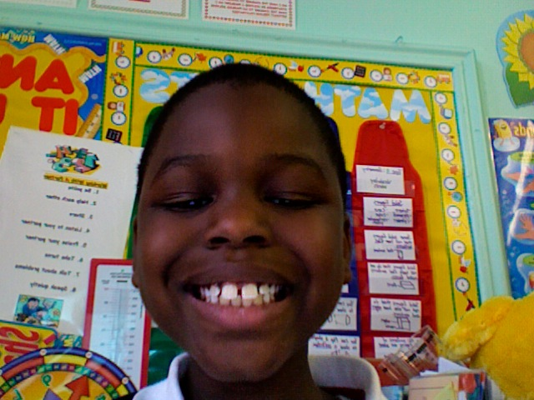
The Lowlands
By Chrisserge Pierre-Louis

Slide 2
Table of Content
Land
Climate in the Netherlands
Transportation
Clog Shoes
Windmills
Tulips

Slide 3
Climate
The Climate in the Netherlands is similar to
the rain forest.
That means it rains a lot.

Slide 4
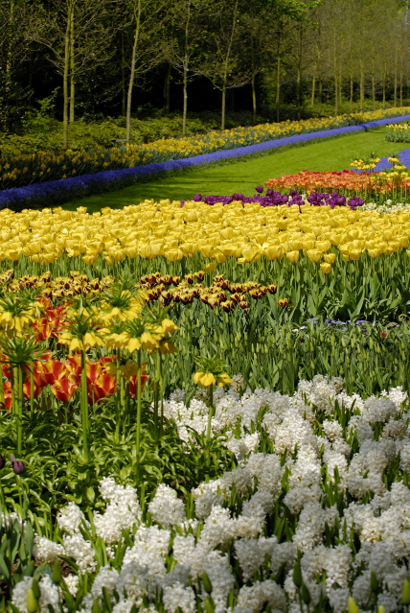
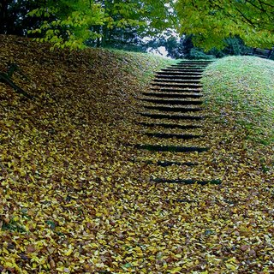
Land
The Netherlands is located in Europe.
It has a few hills and no mountains.
The land is very damp.
It is also made of clay.
This means it is good for farming.

Slide 5
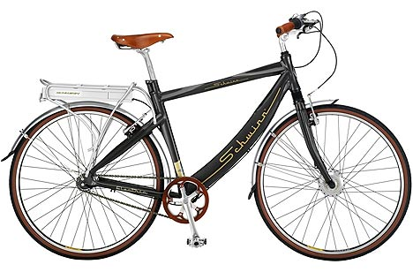
Transportation
Bikes are the most popular kind of
transportation.
Kids as young as 3-4 learn how to ride them to
school.

Slide 6
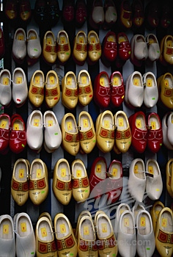
Clog Shoes
The dutch use clog shoes to keep their feet clean and dry.
Some of the dutch think that clogs are comfortable.
The clog shoes are the most popular kind of shoes in the netherlands.
I alwys wanted to wear clogs.

Slide 7
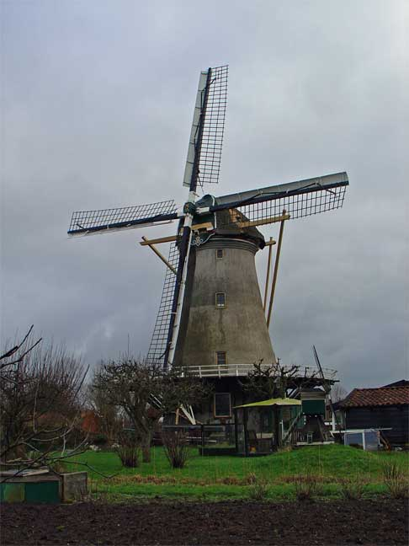
Windmills
Windmills are like giant fans.
Windmills have wooden wheels .
The dutch use windmills to dry the land.

Slide 8
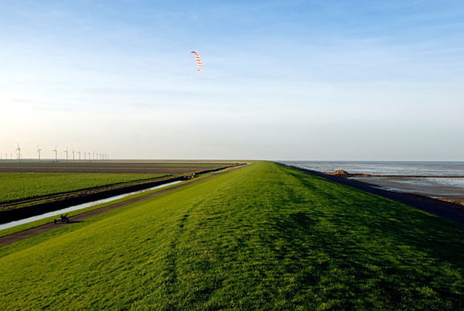
Dikes
Dikes are used to protect the land.

Slide 9
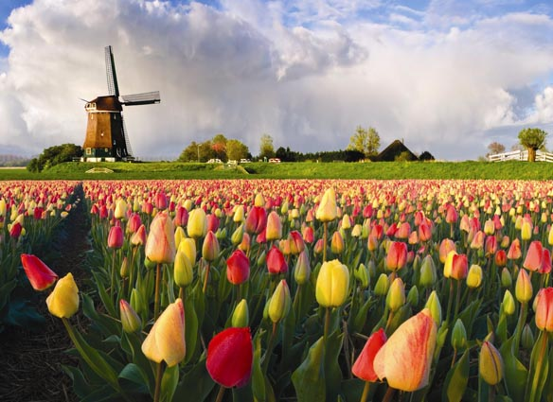
Tulips
Tulips are very popular in the netherlands.
Tulips come in many colors.
Tulips are beautiful.

Slide 10
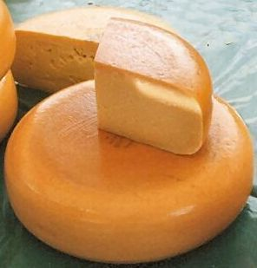
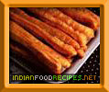
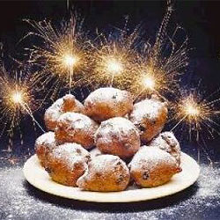
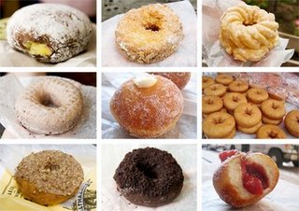
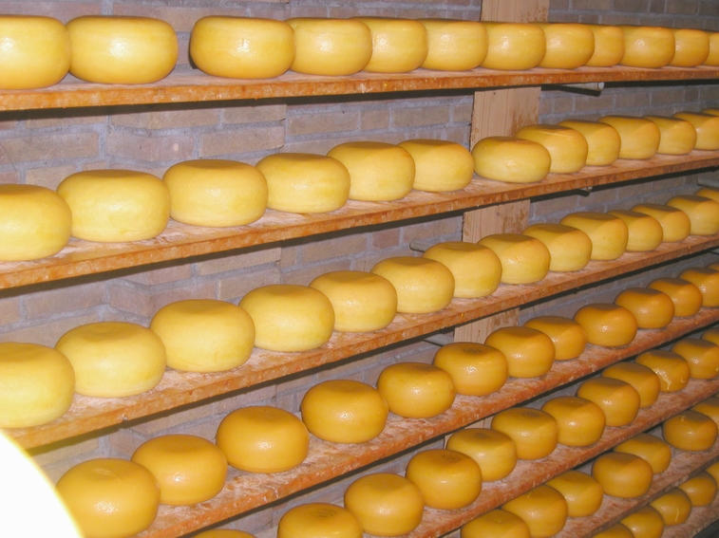
Food
The first food made in the netherlands was a douhnut.
The dutch called it an oil cake.
Oilebollen is another food
It is served on New Year.
Another popular food is a cruller.
There is also Gouda and Edam cheese.

