Slide 1
Nederland
By Brandon Sanders

Slide 2

Table of contents
Windmills
clogs
dikes
lands
flag

Slide 3

windmills
Windmills drain the water in the lowland
Called the netherlands

Slide 4

clogs
Clogs are what the dutch wear in
There lowland

Slide 5

Dikes
The dutch built dikes to stop floods

Slide 6
lands
The dutch has a lowland

Slide 7

flag
The dutchs flag is red,white,and blue.

Slide 8


THE END

Slide 9
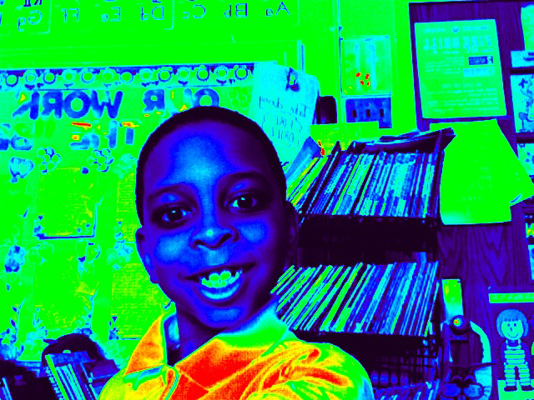
GO TO NETHERLANDS.COM

