Slide 1
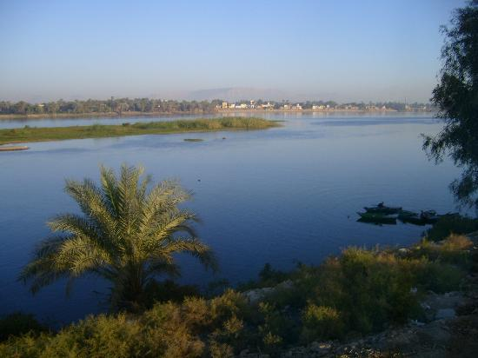
the Nile
By: Yvens Fegond

Slide 2
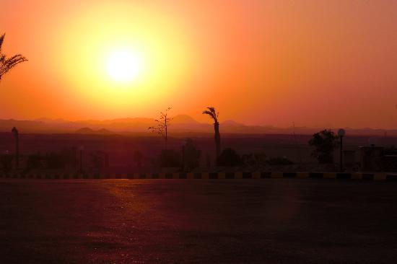
The beautiful Nile
Some time when the sun is going down the Nile change into a red, orange, and pink color.

Slide 3
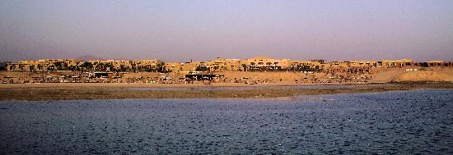
Around the Nile
This is how the Nile look like in daytime. It look sunny and colorful.

Slide 4
Sunset at the Nile
The Nile change into a yellow color when the sun is next to it.

Slide 5
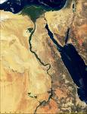
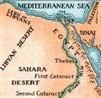
Egypt map
Here are some maps of Egypt.

Slide 6
Internet resources
This is the url I got my pictures
gle.com/images?um=1&hl=en&safe=active&client=safari&rls=en-us&tbs=isch:1&q=nile+pictures&sa=N&start=18&ndsp=18

Slide 7
The End

