Slide 1
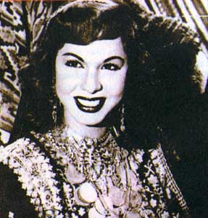
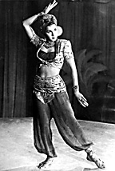
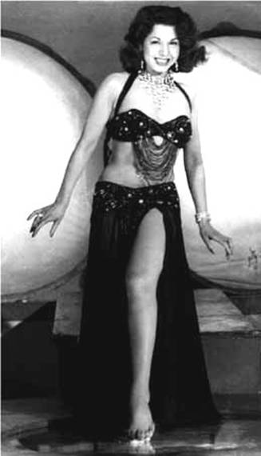
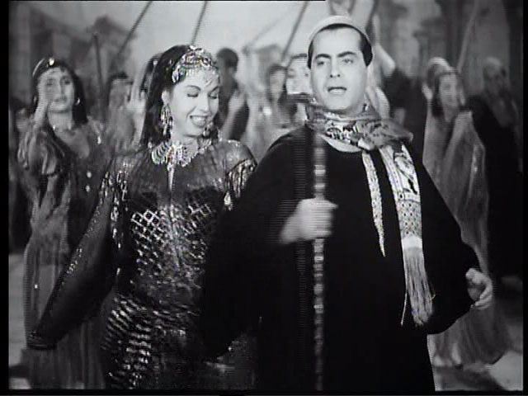
Samia Gamal famous Belly Dancer
By Sharleen Pasha

Slide 2
Samia Gamal
Samia Gamal is a famous Egyptian Belly dancer.
Born 1922 – Died 1994
Samia Gamal birthday is in February 22, 1992
Samia Gamal grew up in Bani, Egypt
Samia Gamal was 72 years 9 Months 4 days old when died.
Samia Gamal belly danced for 11 year
Belly danced for 11 years

Slide 3
How did Samia Gamal become a Star!
Samia Gamal belly danced because she loved it since she was a child. She was the star of the 1950’s . She started of small but began doing very big. The dance she did is westren dance. Samia Gamal loved dancing it was her hobby she then became famous. That is how Samia Gamal become a star.

Slide 4
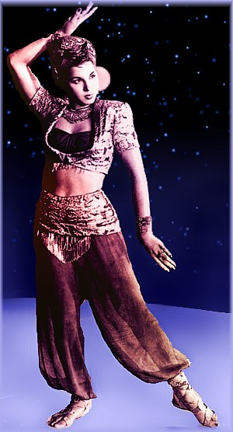
Samia’s first time dancing

Slide 5
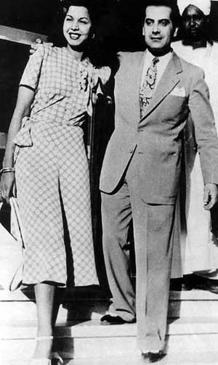
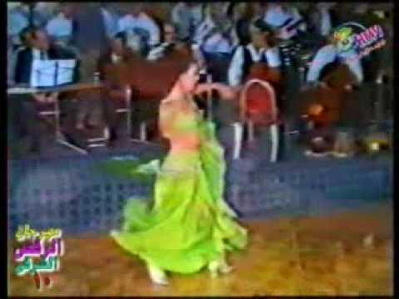
Internet Resources
WWW. Google . Com
En.Wikipedia . Org
WWW. Zaranzouk . couk
WWW. Trueknowleg . com

