Slide 1
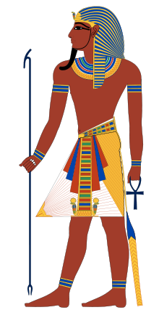
pharaohs
By Jalyn Rose 5-304

Slide 2
pharaohs
The role of the Pharaohs were to help the Egyptians stay under control.
The pharaoh that ruled Egypt the longest was Ramses II.
The pharaohs of Egypt were the king of the kingdoms.

Slide 3
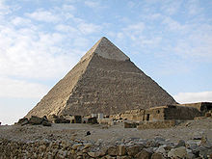
Pyramids of Egypt
The pyramids of Egypt were protected by the sphinx’s.
Inside the pyramids of Egypt were tombs.
Tombs were where the Egyptian pharaohs were put when they died

Slide 4
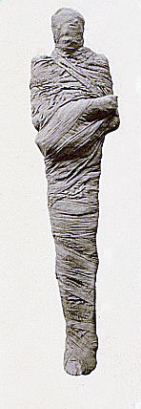
What are inside of tombs?
Inside of a tomb is a mummified pharaohs
The first thing to do when you mummified a pharaoh is the take out all of the internal organs.
It takes up to 70 days for a pharaoh to get mummified

Slide 5
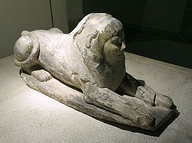
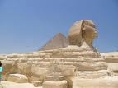
sphinks
Spinks were in Egypt to protect the pyramid
The sphinks had a lion body and a pharaohs head.

Slide 6
biblogrofy
Biblogrofy
en.wikipedia.org/wiki/Ph#119CA1
en.wikipedia.org/wiki/Py#119CC0
en.wikipedia.org/wiki/Sp#119D21

