Slide 1
Egypt
By:IyanaThomas

Slide 2
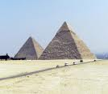
Pyramids
All Pyramids dose not have 4 sides.
Some Pyramids are different colors for Example : their brown and gold. Like this one:
Pyramids are made of sand blocks by other people very long ago.

Slide 3
People in Egypt
People in Egypt are just like people in New York City.
They have a lot of stores in Egypt just like in New York City.
They also clean, cook and work for food and clothes for their family.

Slide 4
Resources
http://www.nationalgeographic.com/pyramids/pyramids.html
http://www.ancientegypt.co.uk/

