Slide 1
Egypt The Best
        Aaron Barker 5-304

Slide 2

Egyptian picture !

Slide 3

Ra he sun god !
Ra is best

Slide 4

A Egyptian image

Slide 5
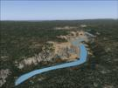
A long river the Nile !
The Nile is the longest river in the world

Slide 6

Egyptian house !
Best

Slide 7
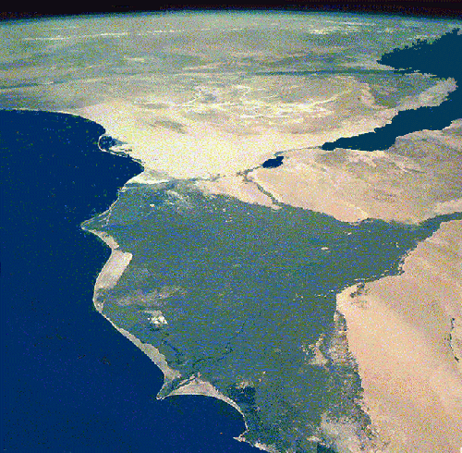
The Nile River from Space!
Its huge

Slide 8
Internet resources:
http://www.google.com
www.wikipedia.com
Ask.com
http://egypt.mrdonn.org/

