Slide 1
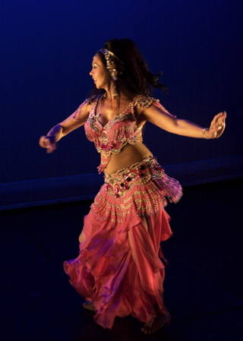
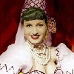
FF
BY FAIZA QAZI

Slide 2
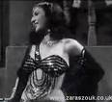
WHO IS NAIMA AKEF?
Naima Akef was born in Cairo on the 7th of October 1929.
Her family owned the Akef circus.
Straight away from childhood, Naima was exposed to acrobats, dance, music and live performances and would take part her self.
She was trained by her grandfather, Ismail Akef to perform at circus.
Naima came first in the competition beating 100 dancers from 50 countries.

Slide 3
A STAR
The Kit Kat club was the another famous in club in Cairo, director Abbas Kemal.
His brother, Hussein Fawzy, also a film director was really interesting in having Naima star in one of his film called “Al- Eich Wal Malh”
The film was a huge success and made her an overnight star at the age of 15
For the next 10 years she worked in his films, and eventually married him in 1952
Naima and her husband divorced in 1958.

Slide 4
FILMOGRAPHY
Aish Wal Malh (1949)
Lahalibo (1949)
Baladi Wa Khafa (1949)
Furigat (1950)
Baba Areess (1950)

Slide 5
RETIREMENT AND DEATH
Naima quit acting in 1964 to take care of her child
He had only one child, from her second marriage to accountant Salah Abdel Aleem
She died two years later from cancer, on April 23, 1966 at the age of 37th.

Slide 6
RESOURCES
http://www.serpentine.org/yasmin/NaimaAkef.html
http://en.wikipedia.org/wiki/Naima_Akef
http://www.belly-dance.org/naima-akef.html

