Slide 1
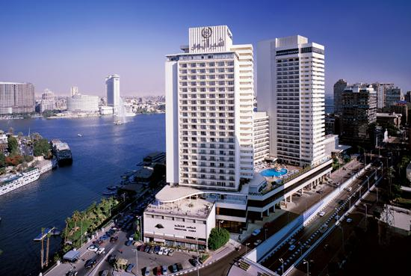
Cairo in the City
By Nagehan-5-303

Slide 2
Cairo in the City
Cairo
Cairo, Egypt
Do you know what Cairo means? Well if you don’t know, let me tell you. Cairo means “The Vanquisher or “The Triumphant”.

Slide 3
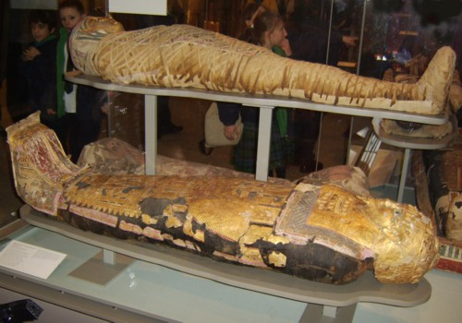
Mummies
Mummies are really interesting. If you want go search it on internet.

Slide 4
Egyptian Facts
Do you know that Cairo is the capital of Egypt? If you don’t well now you know.

Slide 5
Today's Modern Egypt
Today, Greater Cairo encompasses various historic towns and modern districts journey through Cairo is a virtual time travel.

Slide 6
Thank You For Watching
Thank you for watching this power point
This power point is made by Nagehan Ozturk

Slide 7
Bibliography
http/WWW. Google. com
Notes:
8

