Slide 1
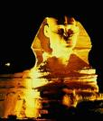
Monuments of Ancient Egypt
by: Rahmel Bailey

Slide 2
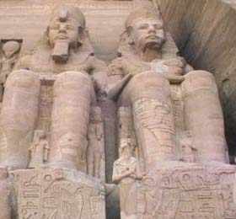
What is monument?
something erected in memory of a person, event, etc., as a building, pillar, or statue.

Slide 3
The Pyramid of Giza
The Great Pyramid at Giza, built by Khufu (Cheops in Greek), is by far the best-known and most impressive of all the Egyptian Pyramids. Its original height was an astounding 481 feet, as high as a 40 story skyscraper and its base covers about 13 acres of land. The Pyramid contains approximately 2,300,000 limestone blocks, the average weight of each about 2.5 tons, the heaviest weighing over 15 tons.

Slide 4
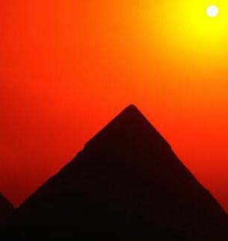
The Pyramid of Giza

Slide 5
The Sphinx
The Great Sphinx also stands on the Giza plateau. This immense sculpture, with the body of a lion and the head of a man, acts as the guardian of the tombs of the great kings according to the Ancient Egyptians. It was probably sculpted out of an unwanted mound of limestone in the desert during the time of Khafre.

Slide 6
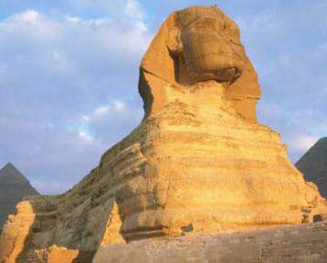
The Sphinx

Slide 7
The Step Pyramid
Egyptologists currently believe that the design for the Egyptian Pyramid was inspired by the fact that the sand dunes in the desert naturally form a pyramidal shape, which is very stable.
The Pyramids themselves developed out of designs of previous tombs. Early Egyptian tombs were bench-shaped mounds called mastabas.
About 2780 B.C., King Zoser's architect, Imhotep, designed the first pyramid by layering six mastabas of decreasing size one on top of the other. Thus, the Step Pyramid was born. This pyramid was used, like its descendants, as a tomb for the dead king.

Slide 8
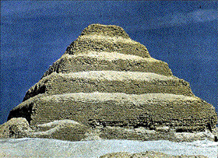
The Step Pyramid

Slide 9
The Egyptian Monument
While the Pyramids are the most recognizable of Egyptian monuments, many other impressive structures were built by the ancients.
Temples were constructed to pay tribute to the gods and the Pharaoh, who was considered a man-god himself. Shown to the right is the impressive Temple of Ramses II, considered to be the most powerful Pharaoh of Ancient Egypt.

Slide 10
The Egyptian Monument

Slide 11
The Cairo Tower
The Cairo Tower is a free standing concrete television tower in Cairo, Egypt.
It stands in the Zamaick district on Geira Island in the Nile River close to the city Centre.
At 187m (610ft) it is 140ft taller than the great pyramid of Giza stands 15km to the southwest.
It is one of Cairo most famous and well know landmarks the Cairo tower was built from 1961 to 1965 reportedly to convince a skeptical world the nation had the capability to construct the Cairo tower one rotation takes about 70 mins.

Slide 12
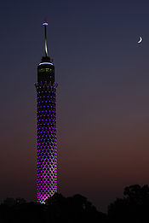
The Cairo Tower

Slide 13
The Bent Pyramid
The Bent Pyramid, located at the royal necropolis of Dahshur, approximately 40 kilometres south of Cairo, of Old Kingdom Pharaoh Sneferu, is a unique example of early pyramid development in Egypt, about 2596 BCE.
This was the second pyramid built by Sneferu.The lower part of the pyramid rises from the desert at a 55-degree inclination, but the top section is built at the shallower angle of 43 degrees, lending the pyramid its very obvious "bent" appearance.
Archaeologists now believe that the Bent Pyramid represents a transitional form between step-sided and smooth-sided pyramids (see Step pyramid).
It has been suggested that due to the steepness of the original angle of inclination the structure may have begun to show signs of instability during construction, forcing the builders to adopt a shallower angle to avert the structure's collapse.
This theory appears to be borne out by the fact that the adjacent Red Pyramid, built immediately afterwards by the same Pharaoh, was constructed at an angle of 43 degrees from its base. Another theory suggests that at the initial angle the construction would take too long because Sneferu's death was nearing, so the builders changed the angle to complete the construction in time.
The Bent Pyramid has a small satellite pyramid which was the final resting place of Sneferu's queen; interestingly there is a connecting tunnel which runs twenty-five metres between the two pyramids, which was built so that Sneferu could visit his queen in the after life.
It also has an early form of offering temple on its eastern side. It is also unique amongst the approximately ninety pyramids to be found in Egypt, in that its original polished limestone outer casing remains largely intact.The ancient formal name of the Bent Pyramid is generally translated as, (The)-Southern-Shining-Pyramid, or Sneferu-(is)-Shining-in-the-South.

Slide 14
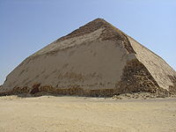
The Bent Pyramid

Slide 15
The Pyramid of Djoser
The Pyramid of Djoser (Zoser), or step pyramid (kbhw-ntrw in Egyptian) is an archeological remain in the Saqqara necropolis, Egypt, northwest of the city of Memphis.
It was built for the burial of Pharaoh Djoser by his vizier Imhotep, during the 27th century BC. It is the central feature of a vast mortuary complex in an enormous courtyard surrounded by ceremonial structures and decoration.
This first Egyptian pyramid consisted of six mastabas (of decreasing size) built atop one another in what were clearly revisions and developments of the original plan.
The pyramid originally stood 62 meters tall, and having a base of 109 x 125 m and was clad in polished white limestone.
The step pyramid (or proto-pyramid) is considered to be the earliest large-scale stone construction, although the nearby enclosure known as Gisr el-mudir would seem to predate the complex.

Slide 16
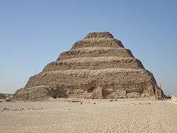
The Pyramid of Djoser

Slide 17
Closing
I’ve told you what a monument is, given facts about some monuments from Ancient Egypt, and I gave you a picture of that monument so I’m sad to say that my power point is official finished.

Slide 18
Bibliography
http://upload.wikimedia.org/wikipedia/commons/8/80/Saqqara_Pyramid_Djoser.jpg
http://library.thinkquest.org/3011/egypt4.htm
http://en.wikipedia.org/wiki/Pyramid_of_Djose
http://en.wikipedia.org/wiki/Cairo_Tower
en.wikipedia.org/wiki/Bent_Pyramid
http://dictionary.reference.com/browse/monument

