Slide 1
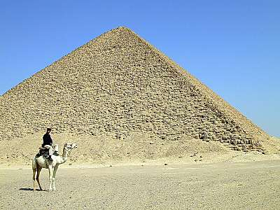
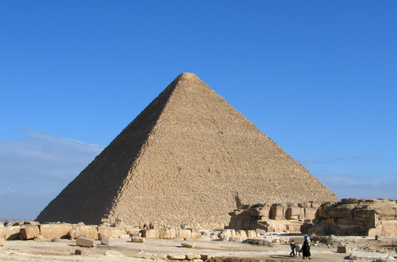
EGYPTIAN PYRAMID
by Bianka severin

Slide 2
information about king tut
On November 26, 1922, Howard Carter made archaeological history by unearthing the first Egyptian pharaonic tomb that still contained most of its treasures. Still, even this tomb had been robbed in antiquity, although the the robbery attempt was apparently thwarted before the thieves could make away with most of the treasure.

Slide 3
.
The Egyptian Pyramids are colossal structures used by the ancient world for religious purposes. The largest and most remarkable of the pyramids occur in several groups on the west side of the Nile extending for a distance of twenty five miles reaching as far as Cairo (the capital city). The are built from hard limestone and large blocks of limestone, especially on the outside surface. They date from 3000 BC to 2300 BC. Great skill was needed to quarry these large blocks, transport them and then place them in position. The Ancient Egyptians were very well organised and they required a good understanding of technology, science and mathematics to enable them to build what has become known as one of the wonders of the ancient world.

Slide 4
Information abou
This article needs additional citations for verification.Please help improve this article by adding reliable references. Unsourced material may be challenged and removed. (September 2009)
A view of the pyramids at Giza from the plateau to the south of the complex. From right to left are the Great Pyramid of Khufu, the Pyramid of Khafre and the Pyramid of Menkaure. The three smaller pyramids in the foreground are subsidiary structures associated with Menkaure's pyramid.Pyramidin hieroglyphs
A view of the Pyramid of Khafre from the Sphinx.The Egyptian pyramids are ancient pyramid-shaped masonry structures located in Egypt.There are 138 pyramids discovered in Egypt as of 2008.[1][2] Most were built as tombs for the country's Pharaohs and their consorts during the Old and Middle Kingdom periods.[3][4] [5]The earliest known Egyptian pyramid is the Pyramid of Djoser (constructed 2630 BCE–2611 BCE) which was built during the third dynasty. This pyramid and its surrounding complex were designed by the architect Imhotep, and are generally considered to be the world's oldest monumental structures constructed of dressed masonry.The best known Egyptian pyramids are those found at Giza, on the outskirts of Cairo. Several of the Giza pyramids are counted among the largest structures ever built.[6]The Pyramid of Khufu at Giza is the largest Egyptian pyramid. It is the only one of the Seven Wonders of the Ancient World still in existence.

Slide 5
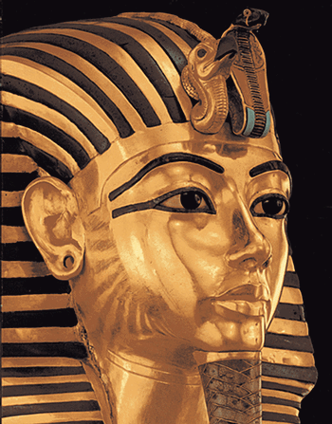
King tut
existence.

Slide 6
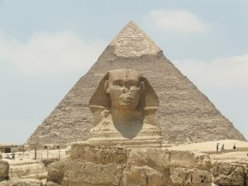
THE GREAT SPHIX

Slide 7
Information about the great sphix
The Great Sphinx of Giza is a statue of a reclining lion with a human head that stands on the Giza Plateau in Giza on the west bank of the Nile, near modern-day Cairo, in Egypt. It is the largest monolith statue in the world, standing 73.5 metres (241 ft) long, 6 metres (20 ft) wide, and 20.22 m (66.34 ft) high.[1] It is the oldest known monumental sculpture, and is commonly believed to have been built by ancient Egyptians of Old Kingdom in 2555 BC to 2532 BC.[1][2]

