Slide 1
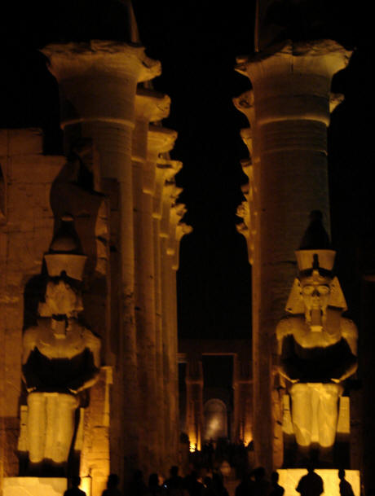
LUXOR DAY & NIGHT
LUXOR
&
IT’S SECRETS
BY
ANGELES TOVAR
5 - 303
BY ANGELES
5 - 303

Slide 2
PARTY TIME
There were many festivals that were celebrated in Thebes which is now called Luxor Egypt.
Luxor held the most important festival, the festival of Opet, which was built largely by AmenhotepIII and Ramesses II

Slide 3
Where in the world is luxor?
Luxor is located on the east bank of the nile river
It has an area of approximately 416 square kilometers[161 sq mi]
Luxor is a city in upper [ southern ] Egypt and the capital of Luxor.

Slide 4
So many people!
Luxor has approximately 376,022 people living there.
Most of them work in the tourist industry.
People from Luxor are very friendly and nice.
Most visitors only meet with the locals used to deal with tourist.

Slide 5
OMG
Did you know that Luxor was called THE CITY OF A HUNDRED GATES.
Luxor was the capital of Egypt from the 12th dynasty [1991 BC] and reached it’s zenith during the new kingdom.

Slide 6
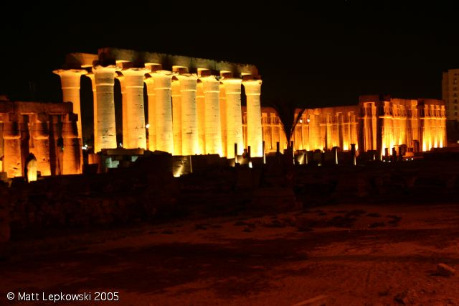
Luxor Egypt at Night

Slide 7
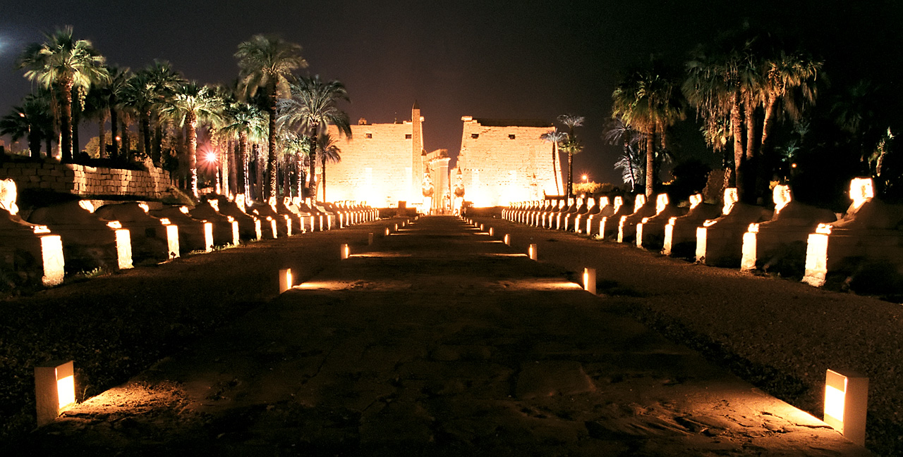
A PATH TO LUXOR

Slide 8
BIBLIOGRAPHY
GOOGLE.COM
www.minamar.com/ luxor-tours-in-egypt.html
My own internet resources

Slide 9
THANK YOU
THANK YOU for spending your time watching my presentation .
I hope you enjoyed it.
Have a good day.
Enjoy the rest.

