Slide 1
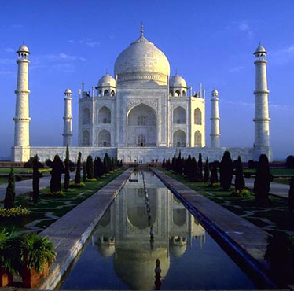
THE TAJ MAHAL
BY
ZEESHAN KHAN 3-205

Slide 2
Table of contents
Purpose of the Taj Mahal
Design
Where it is located
Inside the Taj Mahal
Outside the Taj Mahal
index

Slide 3
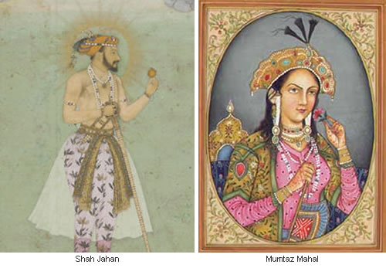
Purpose of the Taj Mahal
The purpose of the Taj Mahal is when Shah Jahan’s
wife Mumtaz Mahal died he built a monument for her.
It was his favorite wife. On her 14 son’s birth she died.

Slide 4
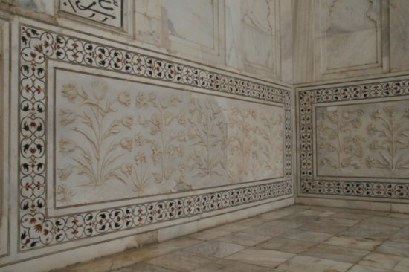
Design
The Taj Mahal is made out of
white marble. It has tombs inside.
It also has designs of flowers
Everywhere.

Slide 5
Where it is located
It is located in Agra, India .
It is very near New Delhi.
It is in the west of the Ganges River and
south of the Himalayas.

Slide 6
Inside the Taj Mahal
There are the tombs inside where Shah Jahan and his wife lay.
There are a lot of pictures because it is now a museum.
It also has some ruins of the Taj Mahal.

Slide 7
Outside the Taj Mahal
There is a pool outside. It reflects the Taj Mahal.
It has minarets at the side and mosques on both sides.
They have lotus flowers in the pool.

