Slide 1
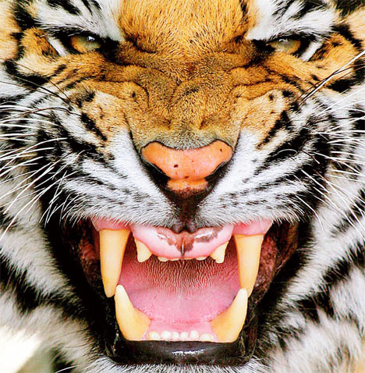
Bengal Tigers
By Ahmad Asif

Slide 2
Table of Contents
What do Bengal Tigers look like like?
Where do they live?
Why are Bengal Tigers one of the endangered species in India?
More facts on the Bengal Tigers

Slide 3
What do Bengal Tigers look like?
Bengal tigers look like giant cats with black stripes. Really, they are a part of the cat family.
Half of the Bengal tiger’s face and bottom part is all white.
Bengal tigers are mostly WHITE, and have black stripes to suit their orange part of their body (the black stripes are also on the white part of their body).
The tip of a Bengal tiger’s tail is black, with dark black and light white rings.

