Slide 1
All about India
Ma’at Peart 3-205

Slide 2
Table of contents
Indian clothing [pg 3]
Indian food [pg 4]
Indian flag [pg 5]
Indian tigers [pg 6]
GandI [pg 7]
Indian rivers [pg8]
INDIAN HOLIDAYS[PG 9]

Slide 3
Indian holidays
Diwali=Official holiday
Holi=Spring festival celebrated by Hindus.
Muharram=First month of the Islamic calender.
Dussehra=Hindu festival of worship and dance.

Slide 4
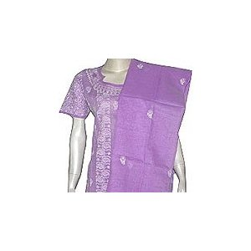
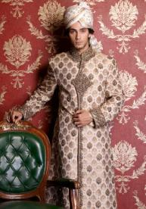
Indian clothing
Women/girls wear saris.
Saris are long Indian dresses that also
Cover the head.
Men/boys wear long-V-neck shirts.
They also wear long baggy pants.

Slide 5
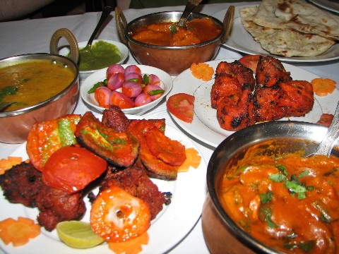
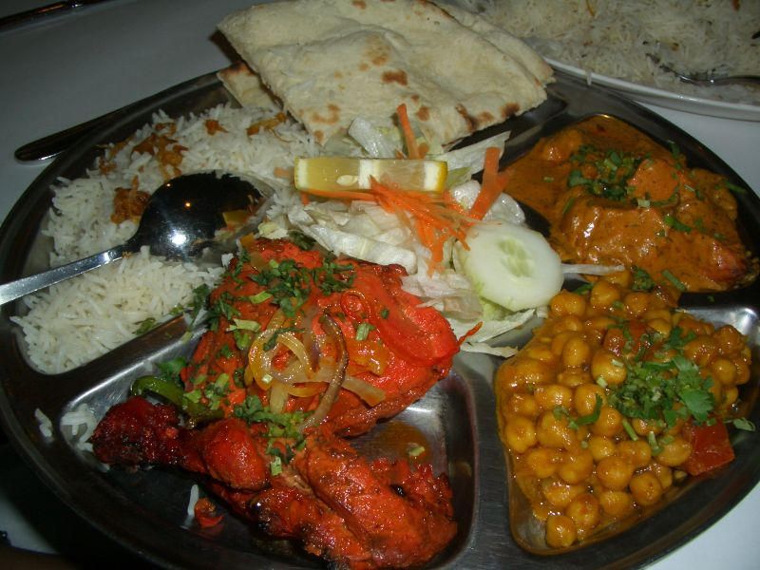
Indian foods
:/
Indian foods are very spicy.indian people eat corn-soup,,dall,and rice.

Slide 6
Indian Flag
The colors on the flag represent different meanings.
Orange=courage and sacrafice
White=purity and truth
Green=faith and fertility
Wheel=respecting India’s laws

Slide 7
Indian tigers
There are many tigers open in India such as the great white tiger and the Bangal tiger.
The White tiger lives near water.
The Bangal tiger lives in the india forests.

Slide 8
Gandhi
Gandi helped bring equality to India.
He started helping India in his early 20’s.

Slide 9
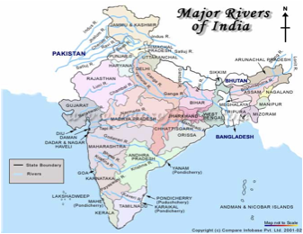
Indian rivers
In the Ganges River people put lost ones ashes there.The river IS VERY DIRTY.

