Slide 1
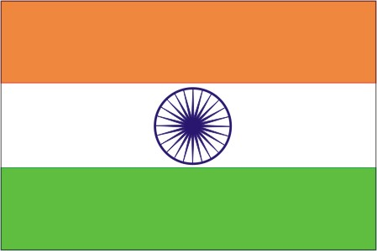
India Flag
Amber Haywood 3-203

Slide 2
Facts about the Indian flag
The India flag is orange, white and green with a blue wheel.
The orange stripe means courage and sacrifice.
The white stripe means purity, truth
The green stripe means faith and fertility.
Courage means brave, not scared.
Sacrifice means to give something up.
Purity means freedom from sin or guilt . Truth means no lies and honesty. Faith means to believe in something or someone.

Slide 3
Where They Bring The Flag
They bring the flag at wars. People fold the flag on Asian elephant.The person who made the indian flag was

