Slide 1
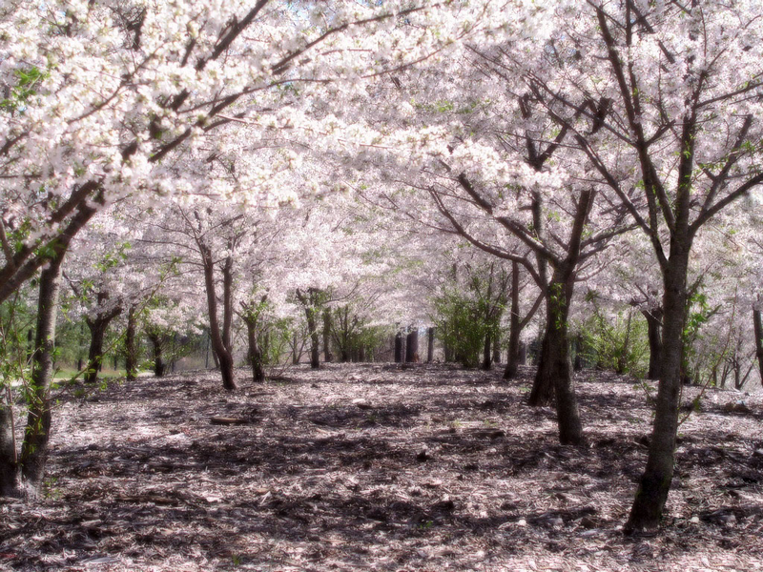
CHERRY BLOSSOM
BY SARAH 2-105

Slide 2
About Cherry BLOSSOMS
Sakura redirects here. For other uses, see Sakura (disambiguation).
Cherry Blossom redirects here. For other uses, see Cherry Blossom (disambiguation).
A Cherry Blossom is the name for the for the flower of cherry trees knonw as Sakura (japanese kanji: hiragang in japanese.In English, the word “sa

